Slide 1
EVALUATING SURVEILLANCE DEFINITIONS FOR VIRAL SUPPRESSION FOR DETECTING BARRIERS TO CARE, 2015-2019
Steven Erly, Leticia Campos, Susan Buskin, Jennifer Reuer

Slide 2
Background: Why is Viral Suppression Important?
Viral suppression is the main way we measure success in HIV care
Requires consistent adherence to ART
U=U
Although the concept is simple, measurement is not
Generally reliant on surveillance data
What we really want to know is viral suppression at a certain point in time
Missing data problem
Purpose: Compare different ways of measuring viral suppression to identify the best for identifying barriers to care

Slide 3
CDC Surveillance Definition
The most common way of measuring viral suppression is the CDC surveillance definition
A person is virally suppressed at a point in time if they have received a viral load in the past 12 months and their most recent viral load is <200 copies/mL
Useful for measuring viral suppression today
Ignores subsequent pieces of information that may be important
Does everyone need to get labs every 12 months?
What does it mean if someone’s next lab is suppressed?

Slide 4
Your turn: Why do we care about precise measurement?
What happens if the CDC viral suppression criteria misclassifies people every so often?
Think: people who are long term survivors and only see their doctor every 12+ months?

Slide 5
Other options
CDC: A person is virally suppressed at a point in time if they have received a viral load in the past 12 months and their most recent viral load is <200 copies/mL
Enriched Criteria- CDC criteria + If someone doesn’t have a lab in the past 12 months look at their next viral load.
Durable Criteria- Examine the year before and after the timepoint of interest. A person is virally suppressed if:
All viral loads in the time period are <200 copies/mL
They became virally suppressed in the time period and all subsequent viral loads were <200 copies/mL

Slide 6
Why this is interesting epidemiology problem
We don’t have a gold standard!
People’s viral loads between tests are unknowable (for us at least)
Can’t use normal methodology and calculate things like absolute sensitivity/specificity, ROC, etc.

Slide 7
Alternative: Misclassification Bias
Let’s assume that our viral suppression definitions are different ways of measuring one concept (actual point in time viral suppression).
The differences between these measures reflect different degrees of misclassification
For now, we will assume that the misclassification is non-differential:
Viral Suppression (True)
Viral Suppression (Measured)
X₁
Exposed
X₁=X₂
Viral Suppression (True)
X₂
Viral Suppression (Measured)
Unexposed

Slide 8
Alternative: Misclassification Bias
In general, non-differential misclassification bias pulls observed effects towards the null
Stronger bias = Smaller Effect Sizes
If we identify exposures that are known barriers to viral suppression, the measure that is closest to the underlying concept will have the largest effect sizes
Measure | Observed Effect Size (F_{i}<1)
True Concept | X
Measure 1 | F₁*X
Measure 2 | F₂*X
Measure 3 | F₃*X

Slide 9
Methods
Study Population: 2015-2019 MMP Participants
Exposures: unstable housing, substance use, poor mental health, heavy drinking, recent incarceration, racism, and poverty.
Outcome: Viral Suppression measured 3 ways (CDC Criteria, Enriched Criteria, Durable Criteria)
Analysis: Compare effect sizes (risk ratio for viremia) for known barriers of care across viral suppression definitions

Slide 10
Results
Of the 858 members of our study population:
752 (85%) were virally suppressed under the CDC criteria
777 (89%) were virally suppressed under enriched criteria
745 (85%) were virally suppressed under durable criteria
CDC vs Enriched: 25 individuals had no viral load in P12M but had a subsequent suppressed viral load (reclassified as suppressed)
CDC vs Durable:
25 as above (reclassified as suppressed)
14 who were on their way to stable viral suppression at the study interview (reclassified as suppressed)
46 who were not stably suppressed (reclassified as not-virally suppressed)

Slide 11
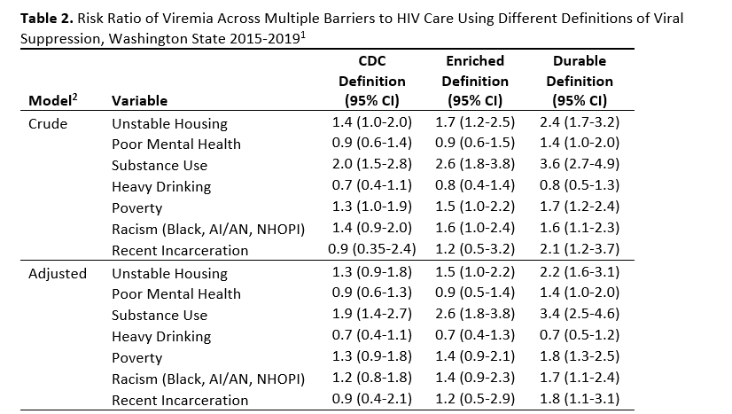
Barriers to care

Slide 12
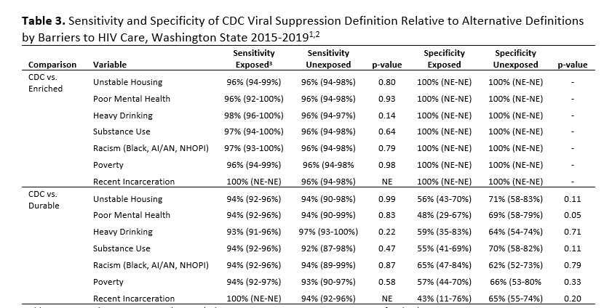
How do we know that our misclassification is non-differential?
If the misclassification of the outcome is also associated with the exposure, then it is not safe to assume that bigger effect sizes mean more reliable measurement.
People who were unstably suppressed
CDC- VS
Durable- VS

Slide 13
How do we know that our misclassification is non-differential?
CDC vs Enriched = Non-differential misclassification
Product of random differences in surveillance quality, appointment scheduling
CDC vs Durable = Potentially differential misclassification
Measures an additional concept (care stability) that is also associated with the exposure
Is this a useful concept for measuring barriers to care?

Slide 14
Conclusion
Researchers attempting to identify barriers to care should consider using our alternative definitions for measuring viral suppression.
The alternative definitions will yield larger effect sizes and be able to detect barriers to care in smaller populations or with smaller impacts
The CDC definition is still useful to monitor progress
The other measures are purely retroactive

